Slide 1

3D Lower Envelopes
Michal Meyerovitch
Dan Halperin
Ron Wein

Slide 2
Outline
What is a lower envelope?
Divide-and-conquer algorithm.
Design and Implementation.
Discussion.

Slide 3
3-D Lower Envelopes
Let F = {ƒ₁, …, ƒ_{n}} be a collection of
partially defined bivariate functions.
The lower envelope E_{F} of F is the pointwise
minimum of these functions:
E_{F}(x, y) = min ƒ_{i}(x, y) ; x, y∈R
If a function ƒ_{i} is not defined over (x, y)
we set ƒ_{i}(x, y)=∞

Slide 4
Minimization Diagrams
Minimization diagram is the partition of the plane into maximal connected regions such that E_{F} is attained by the same subset of functions over each region.

Slide 5
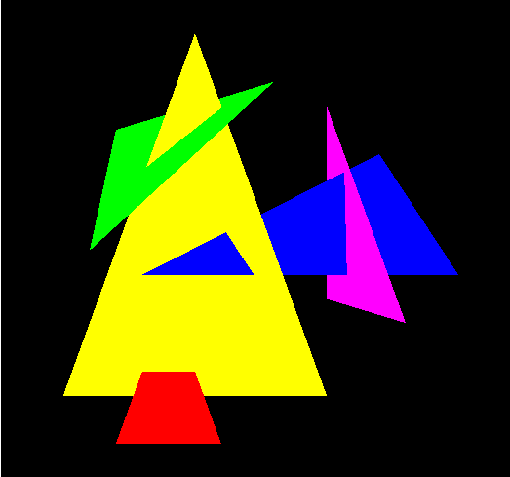
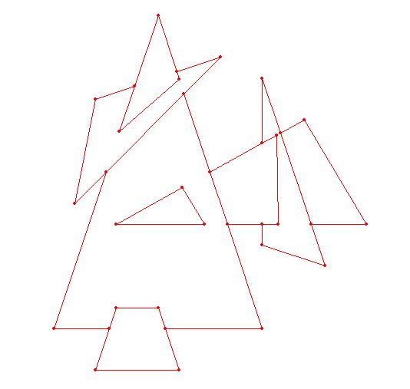
Example
Lower envelope (view from below)
Minimization diagram

Slide 6
How complicated can the Minimization Diagram be?
Its faces may contain holes:

Slide 7
How Complicated Can the Minimization Diagram Be?
“Antennas” may occur:
Faces may contain isolated points in their interior:

Slide 8
Combinatorial Complexity
The maximum combinatorial complexity of the lower envelope of n triangles in R³ is Θ(n² α(n)).
If the triangles are pairwise disjoint the maximum complexity is Θ(n²).

Slide 9
Combinatorial Complexity (cont.)
Let F = {ƒ₁, …, ƒ_{n}} be a collection of partially defined bivariate functions that satisfy:
❖ Each ƒ_{i} is a portion of an algebraic surface of constant maximum degree.
❖ The vertical projection of each ƒ_{i} onto the xy- plane is a planar region bounded by a constant number of algebraic curves of constant maximum degree.
❖ The relative interiors of any 3 surfaces
intersect at s points at most (excluding
overlaps).

Slide 10
Combinatorial Complexity (cont.)
The combinatorial complexity of the lower envelope of F is O(n^{2+ε}), for any ε > 0
(where the constant of proportionality depends on ε and some surface-specific constants).

Slide 11
Divide & Conquer Algorithm
Partition F into 2 sub-collections F₁, F₂ .
Recursively construct the minimization diagrams M₁, M₂ .
Merge M₁, M₂ to obtain the minimization diagram of F.

Slide 12
The Merge Step
Overlay M₁ and M₂.
Solve the envelope shape over each element of the arrangement.
Clean irrelevant elements.

Slide 13
Example (I)
F₁
F₂

Slide 14
Example (II)
After overlaying the minimization diagrams:

Slide 15
Example (III)
Solving the overlaid shape:
What happens in this face?

Slide 16
Example (IV)
Cleanup:

Slide 17
Divide & Conquer - Complexity
The combinatorial complexity of the overlay of the minimization diagrams of two collections of a total of n bivariate “good” functions is O(n^{2+ε}), for any ε > 0.
Thus, the merge step takes O(n^{2+ε}), for any
ε > 0.
And the overall algorithm runs in time O(n^{2+ε}), for any ε > 0.

Slide 18
Implementation
Divide & Conquer algorithm for envelopes is templated with:
  EnvelopeTraits_3 – the geometric traits class.
  MinimizationDiagram_2 – the result class type.

Slide 19
EnvelopeTraits_3 Concept
Refinement of ArrangementTraits_2 concept:
  Curve_2, X_monotone_curve_2, Point_2,
  predicates and operations on these types.
Additional types:
  Surface_3,
  Xy_monotone_surface_3.

Slide 20
EnvelopeTraits_3 Concept Functors (I)
Make_xy_monotone_3
template <class OutputIterator>
OutputIterator operator()
(const Surface_3& srfc,
OutputIterator oi);
Subdivide the given surface into xy-monotone surfaces and insert them into the output iterator.
The iterator value-type is Xy_monotone_surface_3.

Slide 21
Example (I)

Slide 22
EnvelopeTraits_3 Concept Functors (II)
Construct_projected_boundary_curves_2
template <class OutputIterator>
OutputIterator operator()
(const Xy_monotone_surface_3& s,
OutputIterator oi);
Insert all 2D curves, which form of the boundary of the vertical projection of s onto the xy-plane, into the output iterator.
The iterator value-type is Curve_2.

Slide 23
Example (II)

Slide 24
EnvelopeTraits_3 Concept Functors (III)
Construct_projected_intersections_2
template <class OutputIterator>
OutputIterator operator()
(const Xy_monotone_surface_3& s1,
const Xy_monotone_surface_3& s2,
OutputIterator oi);
Insert all the 2D projections (onto the xy-plane) of the intersection objects between s₁ and s₂ into the output iterator.
The iterator value-type is Object.

Slide 25
EnvelopeTraits_3 Concept Functors (III)
An Object may be:
  A pair<Curve_2,Intersection_type>, where the intersection type is an enumeration that can take the values {Transversal, Tangency, Unknown}.
  A Point_2 instance (in degenerate cases).

Slide 26
Example (III)

Slide 27
EnvelopeTraits_3 Concept Functors (IV)
Compare_distance_to_envelope_3
Comparison_result operator()
(const Point_2& p,
const Xy_monotone_surface_3& s1,
const Xy_monotone_surface_3& s2);
Check if the surface s₁ is closer/equally distanced/farther from the envelope with respect to the s₂ at the xy-coordinates of p.

Slide 28
Example (IV)

Slide 29
EnvelopeTraits_3 Concept Functors (IV)
Compare_distance_to_envelope_3 (cont.)
Comparison_result operator()
(const X_monotone_curve_2& c,
const Xy_monotone_surface_3& s1,
const Xy_monotone_surface_3& s2);
Check if the surface s₁ is closer/equally distanced/farther from the envelope with respect to the s₂ in the interior of c.

Slide 30
Example (IV)
(from the xy-plane)
(from the xz-plane)

Slide 31
EnvelopeTraits_3 Concept Functors (V)
Compare_distance_to_envelope_left_3
Comparison_result operator()
(const X_monotone_curve_2& c,
const Xy_monotone_surface_3& s1,
const Xy_monotone_surface_3& s2);
Check if the surface s₁ is closer/equally distanced/farther from the envelope with respect to the s₂ immediately to the left of the curve c.

Slide 32
EnvelopeTraits_3 Concept Functors (VI)
Compare_distance_to_envelope_right_3
Comparison_result operator()
(const X_monotone_curve_2& c,
const Xy_monotone_surface_3& s1,
const Xy_monotone_surface_3& s2);
Check if the surface s₁ is closer/equally distanced/farther from the envelope with respect to the s₂ immediately to the right of the curve c.

Slide 33
Example (V, VI)

Slide 34
EnvelopeTraits_3 Concept Functors (VII)
Is_vertical_3
bool operator()
(const Xy_monotone_surface_3& s);
Check if the surface s is “vertical” with respect to the xy-plane, i.e. it is xy-monotone only in the weak sense.

Slide 35
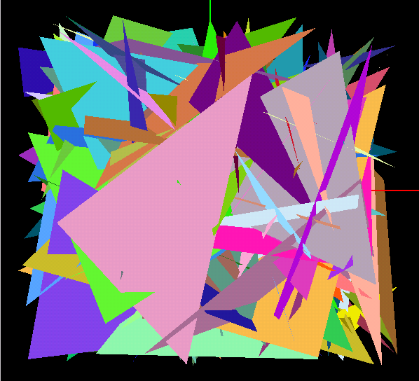
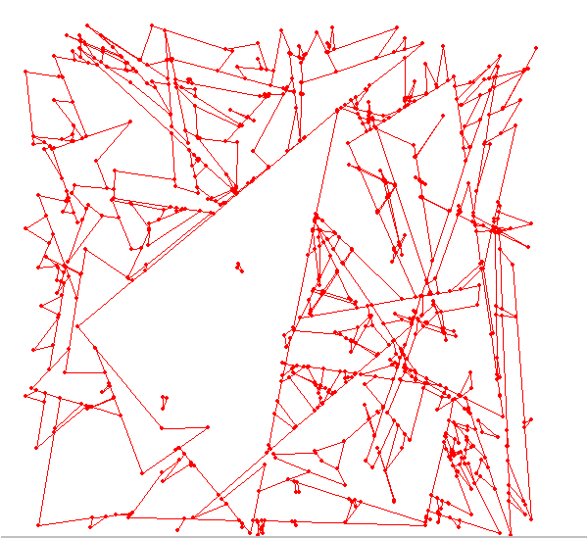
Existing Traits Classes (I)
Handling 3-D triangles (extension of the arrangement segment-traits):

Slide 36

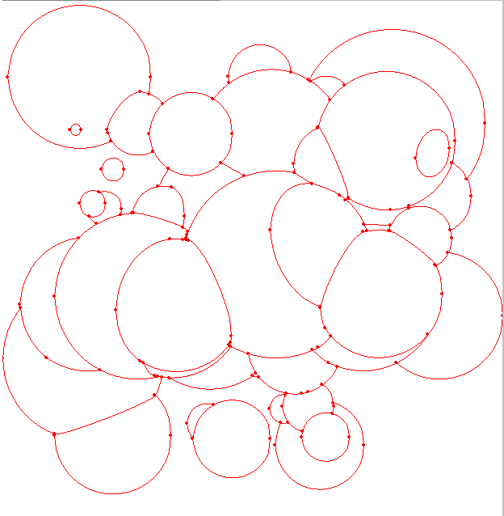
Existing Traits Classes (II)
Handling spheres (extension of the arrangement conic-arc traits):

Slide 37
Discussion –
Implementation Issues
Should we have an Envlope_3 class, or a free (global) function that constructs the minimization diagram of a set of input surfaces?
Currently, the traits define the type of envelope (lower, upper, other), hence the “compare distance to envelope” predicates.
Should this concept change?
Is the set of predicates and constructions defined by the traits concept minimal?

Slide 38
Discussion –
Algorithmic Issues
Devise an efficient algorithm for the incremental construction of envelopes (inserting one surface at a time).
Develop an output-sensitive algorithm.
Special case: enveloped of 3-D meshes.
Devise a perturbation method for a robust fixed-precision computation of envelopes.

